Slide 1
Car Retail System

Slide 2

Members
Youssef Mustafa Ibrahim
Mahmoud Ahmed Hesham
Khaled Alaa Shoukry
Youssef Hatem Mohamed
Anas Magdy Salah
20104848
20104039
20108424
20108429
20108429

Slide 3
TABLE OF CONTENTS
01
SUMMARY
02
Rough & Final ERD
03
SQL Statements
04
Complex queries

Slide 4
Summary
ElLaithy Auto Groups, a car retail company, requested a database for their system that keep track of the company’s interactions and be able to extract useful information from such database. The available entities that can interact with the company are vendors, clients, and insurance companies. Moreover, Such Entities are defined by several factors. The company itself has several warehouses, each of which has several cars (products). In addition, there’re several departments in the company where several employees work in.
For more information about editing slides, please read our FAQs or visit Slidesgo School:
https://slidesgo.com/faqs and https://slidesgo.com/slidesgo-school

Slide 5
ER SCHEMA

Slide 6
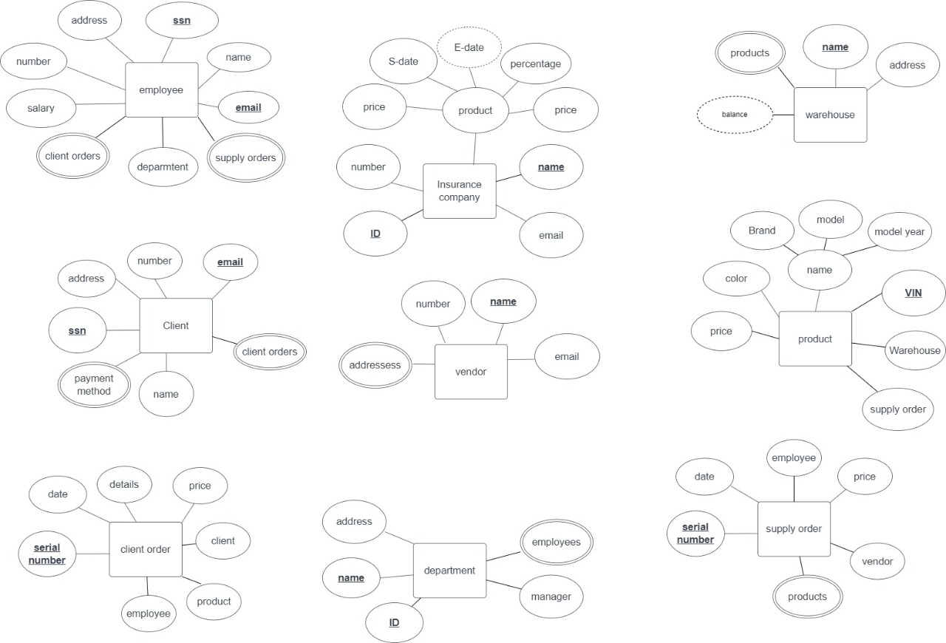
ROUGH ER SCHEMA

Slide 7
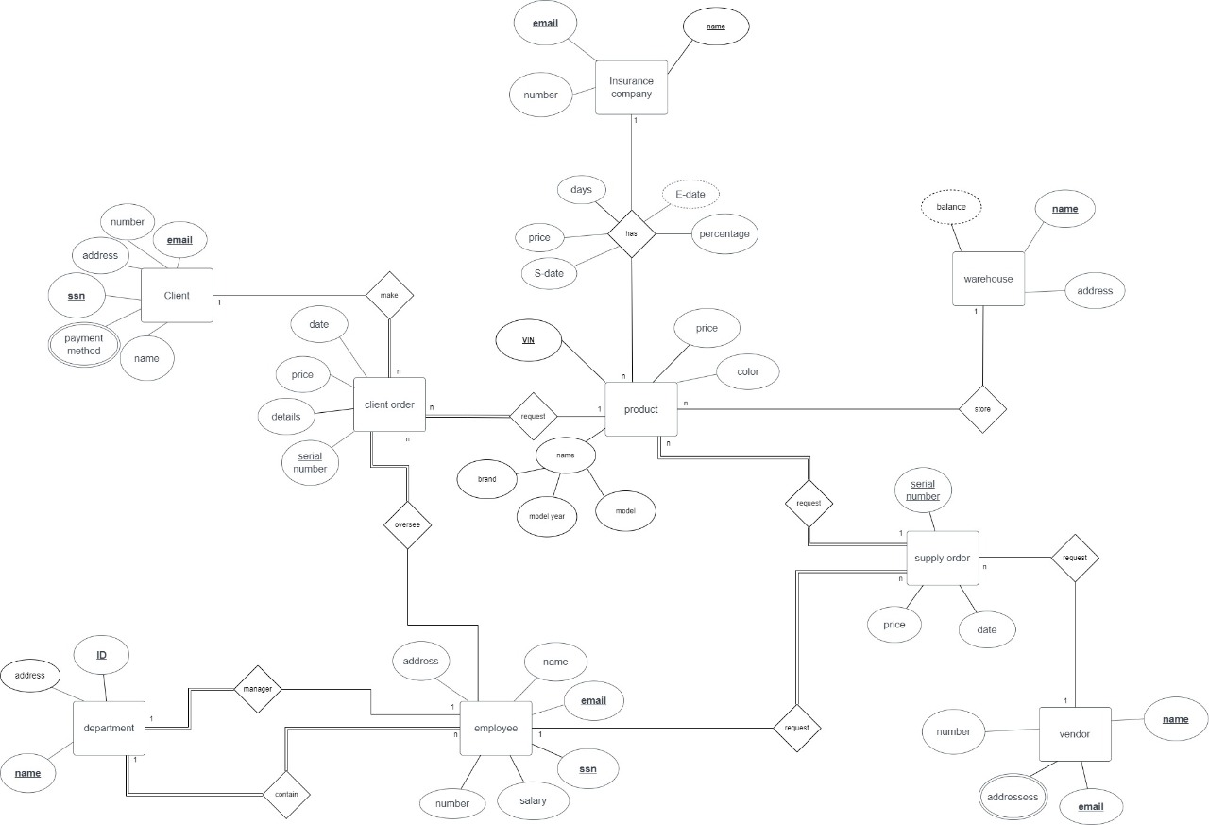
FINAL ER SCHEMA

Slide 8
SQL STATEMENTS

Slide 9
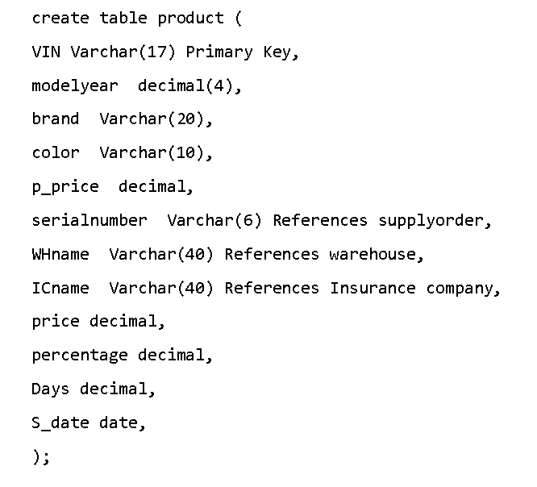
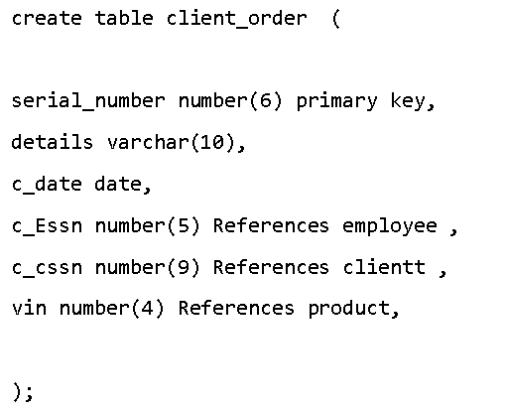
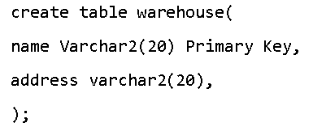
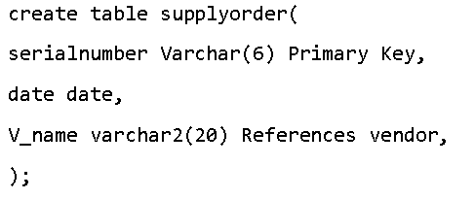
Create statements

Slide 10
TRIGGERS

Slide 11
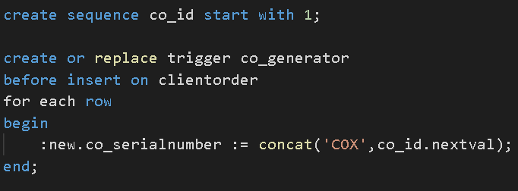
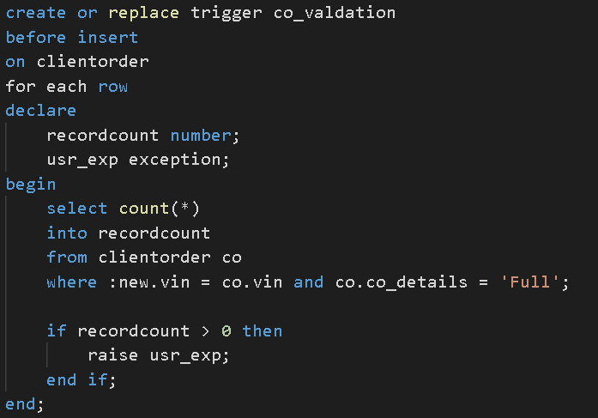
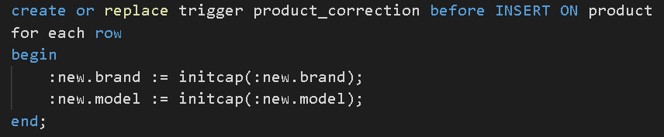

Slide 12
Complex queries

Slide 13
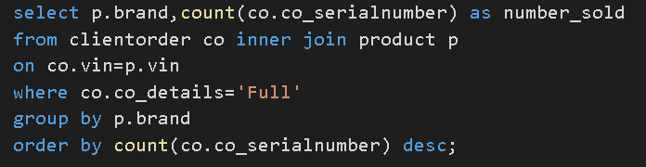
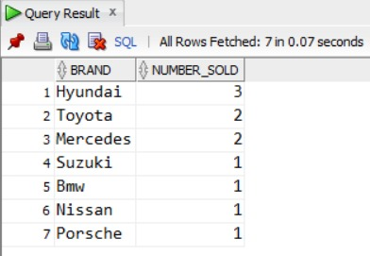
Most Sold brands ranked
This query is made to return the most sold car brands so that the company can decide to focus on which brand/vendor.

Slide 14
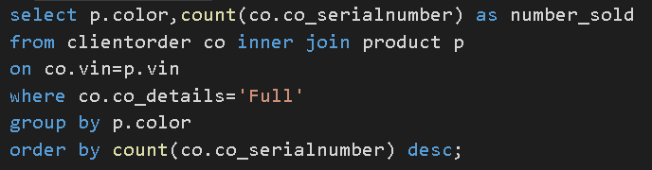
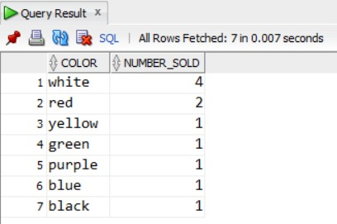
Most sold colors
This query is made to return the most sold car colors so that the company can further understand the customers’ preferences.

Slide 15
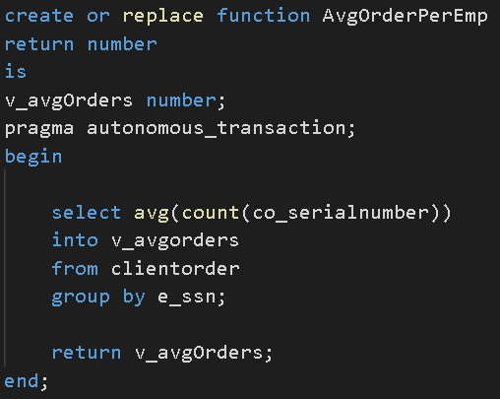
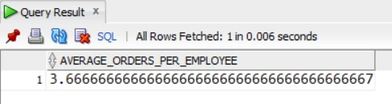
Average number of orders per employee
This query is made to return the average number of orders each employee made. Will be used for another query.

Slide 16
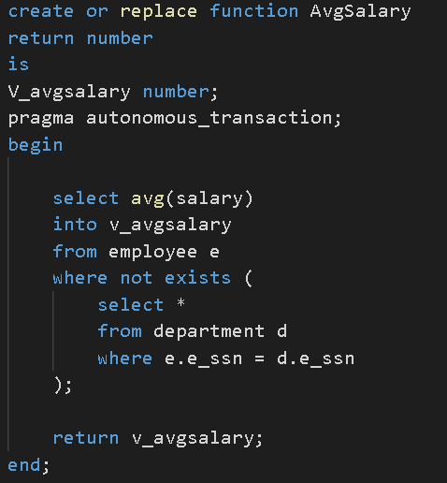
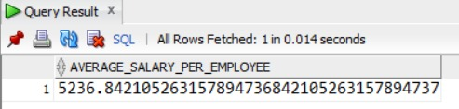
Average salary of employees
This query is made to return the average salary of the employees in the company. Managers are excluded from said query.

Slide 17
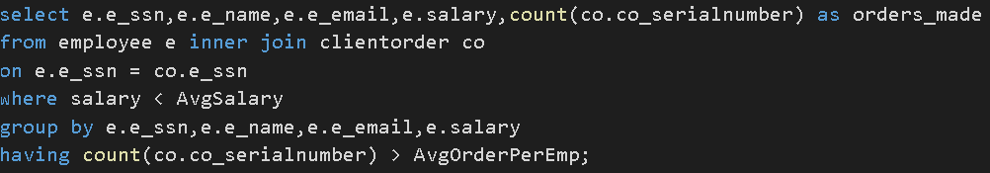
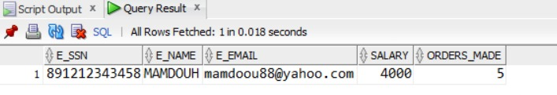
Employees who need promotion
In the company, employees who deserve promotion are decided when they surpass the average number of orders, and their salary is lower than the average salary in the company.

Slide 18
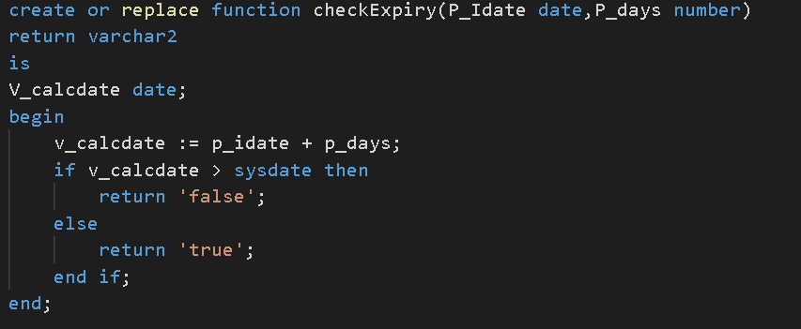
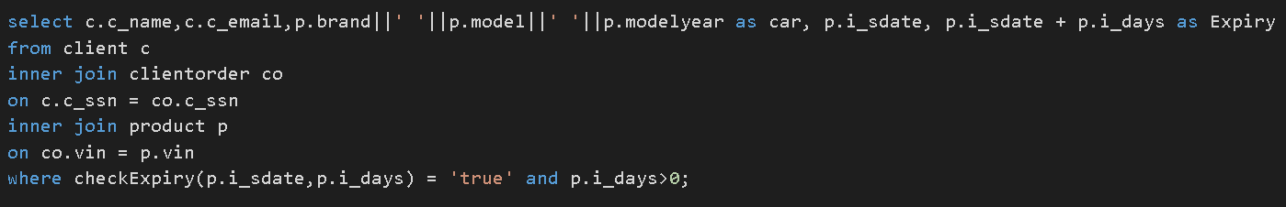
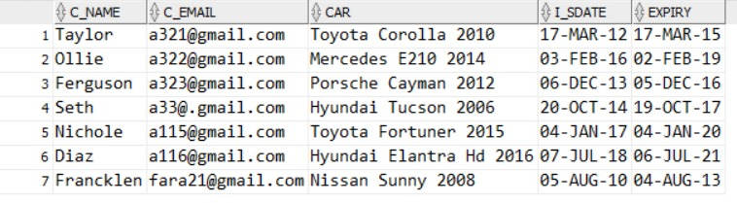
Clients who bought cars and have expired insurance
This query is made to return the customers who has expired insurance in their cars so the company can contact them about said insurance.

Slide 19
THANKS!

